Slide 1
Generative AI at Work
Use Midjourney /Dall E to Generate images from text
Document Insights Extraction - Steps
Summary & Entity extraction using Generative AI
Ram N Sangwan

Slide 2
Use Midjourney /Dall E to Generate Images From Text

Slide 3
What is Midjourney AI?
Initially, Midjourney offered a free trial through which you could test the service by requesting a limited number of images.
Unfortunately, the site ended the free trial for now, with the CEO blaming the move on a surge of new users.
That leaves you with no option but to sign up for one of the paid subscription plans.

Slide 4
What is Midjourney AI?
Midjourney AI is an artificial intelligence program that generates images from textual descriptions.
It's a powerful tool for creating unique designs for print-on-demand products and other applications.
Midjourney AI is similar to OpenAI's DALL-E or Stable Diffusion, which also generates images from textual descriptions using AI.

Slide 5
What is Midjourney AI?
However, Midjourney AI uses a different technology that enables it to generate high-resolution images with more ease and efficiency.
The program allows users to adjust various parameters to create specific types of images.
Midjourney AI also supports multi prompts, prompt weights, and negative prompt weights, etc. to give users greater control over the generated output.
Midjourney AI is known for its ability to generate images in high resolution, making it suitable for use in a wide range of applications.

Slide 6
What is Midjourney AI?
Its user-friendly interface makes it easy for users to start generating images right away, even if they have no prior experience with AI.
It is a powerful and versatile tool with the potential to revolutionize the way we create visual content.
Whether you're an artist, designer, or simply interested in the possibilities of AI-generated images, Midjourney AI is definitely worth exploring.

Slide 7
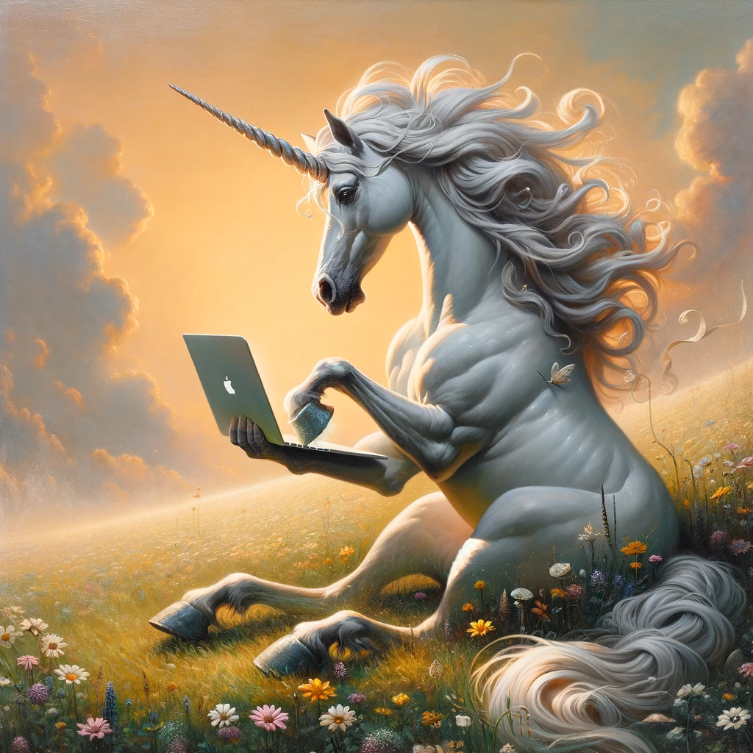
Use Dall E to Generate images from text
Life imitates art, or does art imitate life? With OpenAI's DALL-E 2, art can imitate just about anything.
The text-to-art platform allows users to generate images with their words instead of art supplies.
It sounds almost too simple to be true -- type your idea into a text bar, and voila!
Image created with the prompt, "a painting of a unicorn typing on a laptop".
https://openai.com/dall-e-2
https://labs.openai.com/

Slide 8
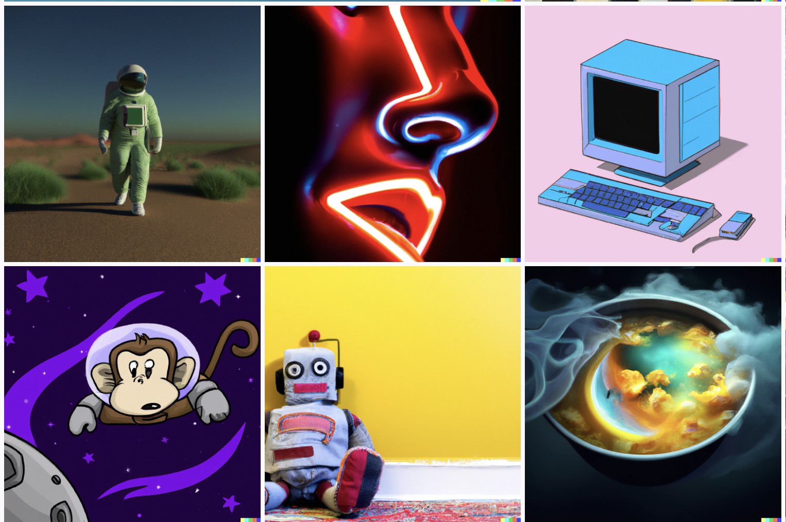
How to use DALL-E 2
Step 1: Log in to OpenAI.
Step 2: Open AI will introduce you to DALL-E 2. Select Continue to get started with the AI.
OpenAI will then explain its credit process, or how you are able to use DALL-E 2 over time.
Step 3: On DALL-E 2’s home screen, you’ll see a few different options to get started.
You can type in a description of your own, upload an image for the AI to edit based on your instructions, or choose Surprise me, which will auto-generate a description that’s designed to play well with the AI.
Remember, you only have a limited number of credits, so plan carefully.

Slide 9
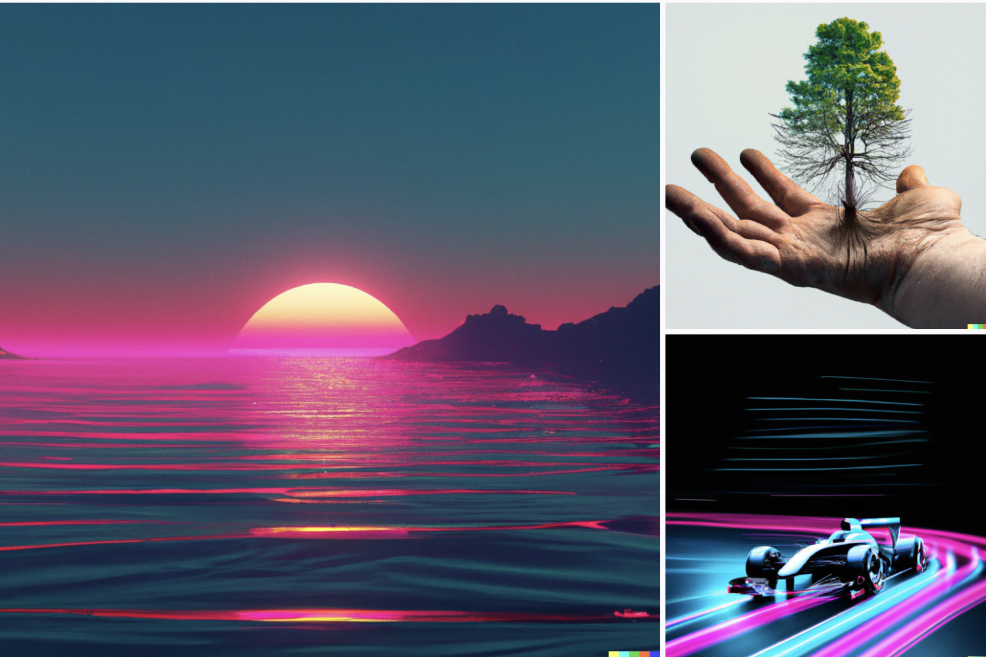
How to use DALL-E 2
Step 4: Type your description in 400 characters, so be specific.
DALL-E 2 plays well with artistic imagery, so don’t be afraid to ask for a painting, stained glass, digital art, or another specific medium that you want to try.
Select Generate when you are ready.
Step 5: For each request, DALL-E 2 will generate several different images for you to pick from.
Find one you like, and use the buttons in the upper-right corner to either favorite it for a later look or download it right now.
Step 6: If the image isn’t quite what you want, you can try selecting Variations, which will generate a new selection based on the image you chose.

Slide 10
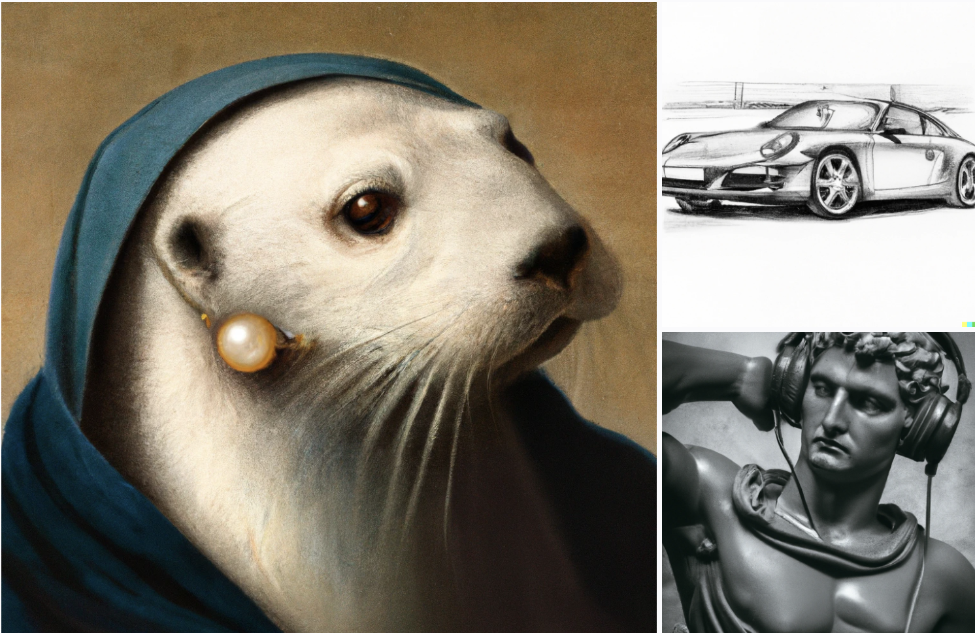
How to use DALL-E 2
Or you could go back and try to tweak your phrase to get a different result.
Step 7: Sometimes changing just one or two different words, or specifying a different medium, can make a lot of difference.
Rethink how you want the image and try for something new if necessary.
The results can be unexpected, but that's half the fun.

Slide 11
Document Insights Extraction – Steps
Summary & Entity Extraction using Generative AI

Slide 12
Example: Implementation Steps
Step 1: Choose the AI Model
Select a pre-trained Generative AI model that has capabilities for natural language understanding and generation, such as Cohere Command or similar.
Step 2: Preprocess the Input Document
Text Extraction: If the document is not in text format (e.g., PDF or Image), use an OCR (Optical Character Recognition) tool to convert it to text. Model may not be able to extract the text directly.
Data Cleaning: Clean the text to remove any irrelevant sections or artifacts from OCR.
Step 3: Summarization
Summarization API Call: Use the chosen AI model's summarization feature such as Cohere Summarize to generate a concise summary of the document.
This might involve a specific API endpoint or a fine-tuned model for summarization.

Slide 13
Implementation Steps
Step 4: Entity Extraction
Entity Extraction API Call: Use the same or a different AI model that's trained for Named Entity Recognition (NER) to extract entities from the text.
Customization: Depending on the AI provider, you may need to fine-tune the model to improve entity recognition specific to the domain of your documents.
Step 5: Integration
API Integration: Integrate both the summarization and entity extraction functionalities into a single workflow.
User Interface: Develop a user-friendly interface where users can upload documents and receive insights.

Slide 14
Implementation Steps
Step 6: Postprocessing
Consolidation: Merge the summary and the entities extracted into a coherent format, suitable for presentation.
Highlighting Entities: Optionally, create a version of the summary where extracted entities are highlighted for easy reference.
Step 7: Output Presentation
Display Results: Show the summary and entities to the user in the UI. This might be a web page or a software application.
Export Options: Provide options to export the results, for example, as a PDF or a text file.

Slide 15
Implementation Steps
Step 8: Continuous Learning
Feedback Loop: Implement a mechanism for users to provide feedback on the accuracy of the summary and entities extracted.
Model Retraining: Use the feedback to retrain or fine-tune the model to improve accuracy over time.

Slide 16
Example: Entity Extraction Tool Workflow
User uploads a document to the tool's interface.
The document is converted to text if needed using OCR.
Text is preprocessed to remove noise and prepare for analysis.
The summary is generated by the AI model, providing a condensed version of the document's content.
Entities are extracted by the AI model or a specialized NER tool, identifying names, organizations, dates, etc.
Results are consolidated and displayed, showing the summary and extracted entities.
Users can provide feedback, which is used for model improvement.

Slide 17
Example Models
To perform document summary and entity extraction using Generative AI, you can utilize a combination of pre-trained models and libraries like BART (Bidirectional and AutoRegressive Transformers), HuggingFace's Transformers library, and spaCy for entity recognition.

Slide 18
Code Snippet
import torch
from transformers import BartTokenizer, BartForConditionalGeneration
import spacy
# Load pre-trained BART model and tokenizer
model_name = 'facebook/bart-large-cnn'
model = BartForConditionalGeneration.from_pretrained(model_name)
tokenizer = BartTokenizer.from_pretrained(model_name)
# Load spaCy model for entity recognition
spacy_model = 'en_core_web_sm'
nlp = spacy.load(spacy_model)

Slide 19
Code Snippet
# Function to generate document summary
def generate_summary(document):
input_ids = tokenizer.encode(document, return_tensors='pt')
output = model.generate(input_ids, num_beams=4, max_length=150, early_stopping=True)
summary = tokenizer.decode(output[0], skip_special_tokens=True)
return summary
# Function to extract entities
def extract_entities(document):
doc = nlp(document)
entities = [(ent.text, ent.label_)

Slide 20
Thank You

